Slide 1
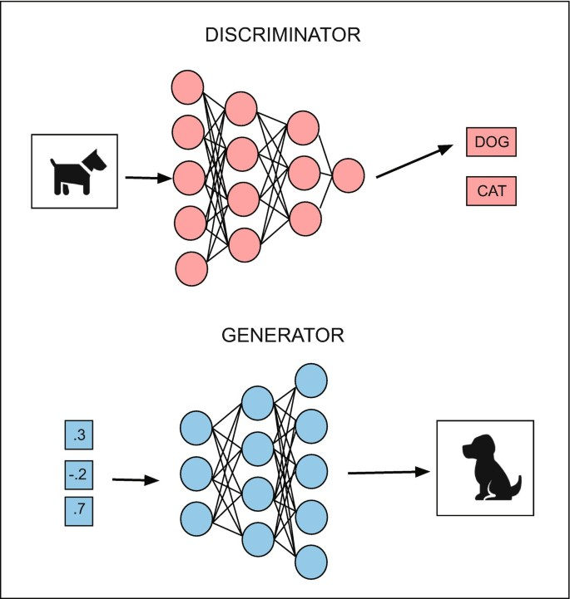

Overview of Generative Models I: GANs
张江
北京师范大学系统科学学院教授
集智俱乐部、集智学园创始人
集智研究中心理事长
更多“人工智能 & 复杂系统”的知识，请关注官网：campus.swarma.org
Notes:
封面

Slide 2


What is AIGC?
a Hacker and a witch sit together, Hacker working on a portable laptop computer, head covered by the hood, fire flare come out of computer screen, deep dark night, dark forest with tall trees with twisted branches, magical sparkling light in the air, 8K, sharp focus, studio photo, intricate details, highly detailed, by greg rutkowski"

Slide 3

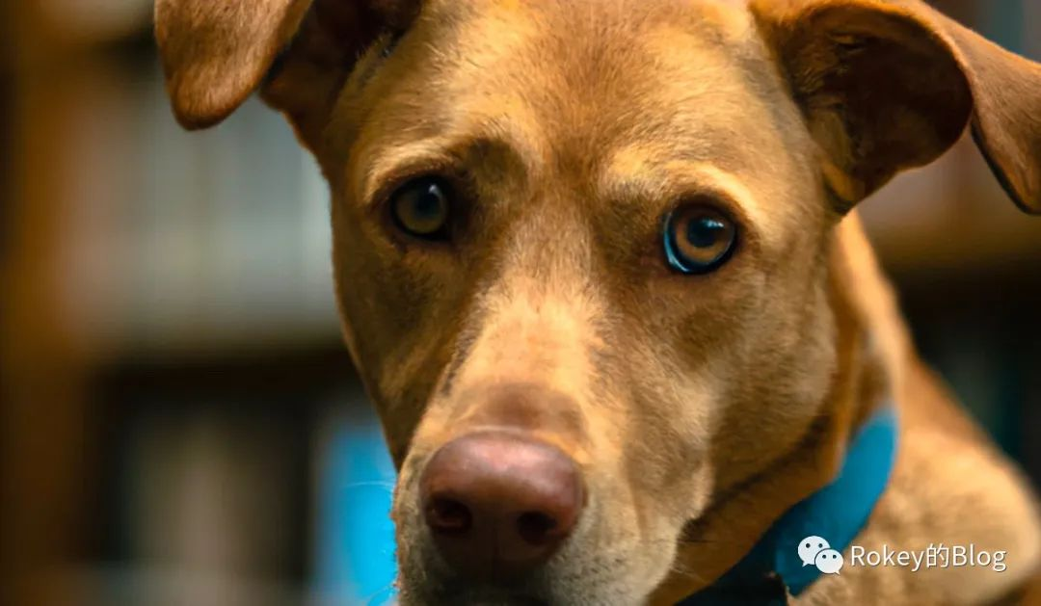
领略一下现在的AI生成艺术
a Hacker and a witch sit together, Hacker working on a portable laptop computer, head covered by the hood, fire flare come out of computer screen, deep dark night, dark forest with tall trees with twisted branches, magical sparkling light in the air, 8K, sharp focus, studio photo, intricate details, highly detailed, by greg rutkowski"

Slide 4
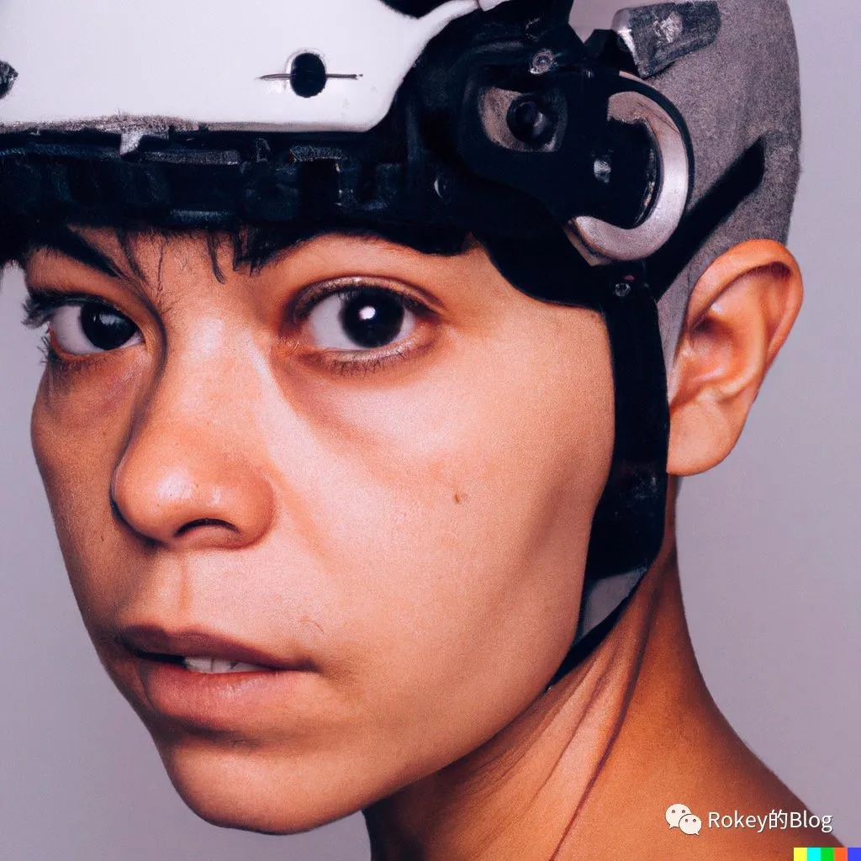
领略一下现在的AI生成艺术

Slide 5
Super Resolution Reconstruction
更多“人工智能 & 复杂系统”的知识，请关注官网：campus.swarma.org

Slide 6
Image Completion
更多“人工智能 & 复杂系统”的知识，请关注官网：campus.swarma.org

Slide 7
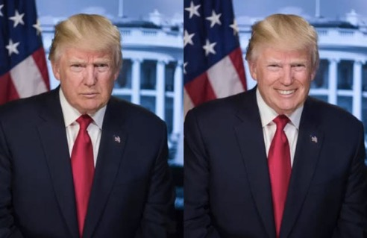
FaceAPP
更多“人工智能 & 复杂系统”的知识，请关注官网：campus.swarma.org

Slide 8

Replacing object in video
更多“人工智能 & 复杂系统”的知识，请关注官网：campus.swarma.org

Slide 9
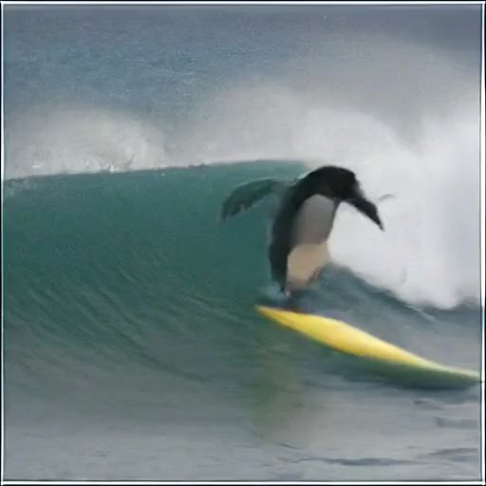
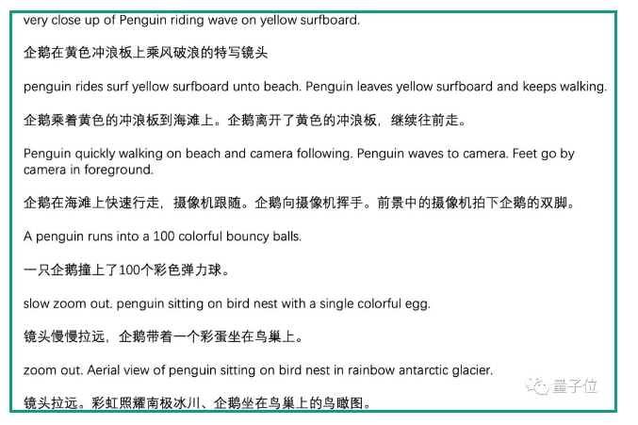
Text-to-Video
更多“人工智能 & 复杂系统”的知识，请关注官网：campus.swarma.org

Slide 10
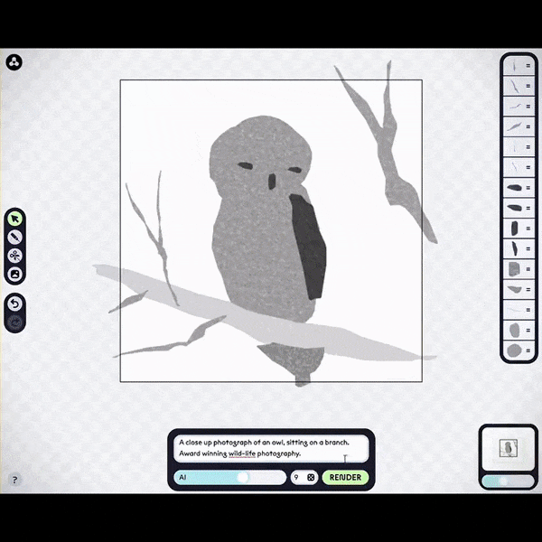
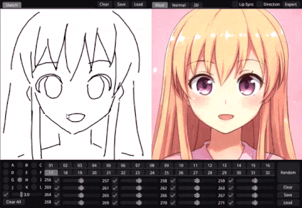
Art assistant
更多“人工智能 & 复杂系统”的知识，请关注官网：campus.swarma.org

Slide 11
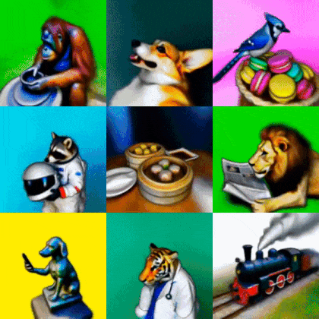
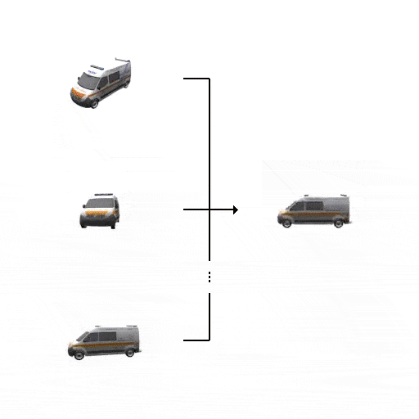
2D→3D
https://dreamfusion3d.github.io/
https://3d-diffusion.github.io

Slide 12
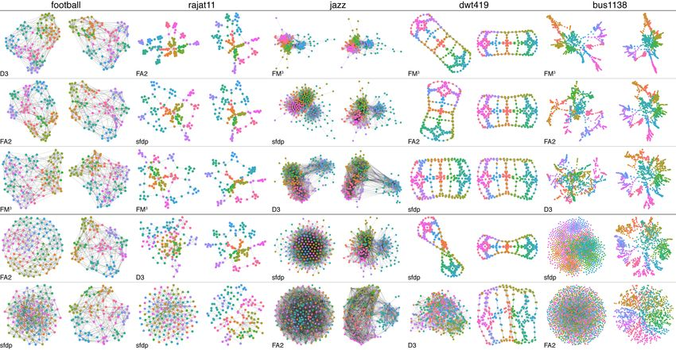
Graph Generation
https://arxiv.org/pdf/2007.06686.pdf

Slide 13
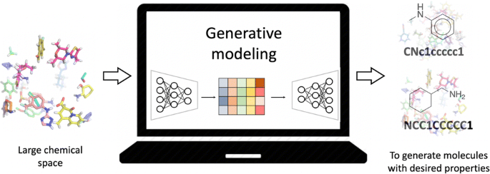
Molecular Structures
https://link.springer.com/article/10.1007/s00894-021-04674-8

Slide 14
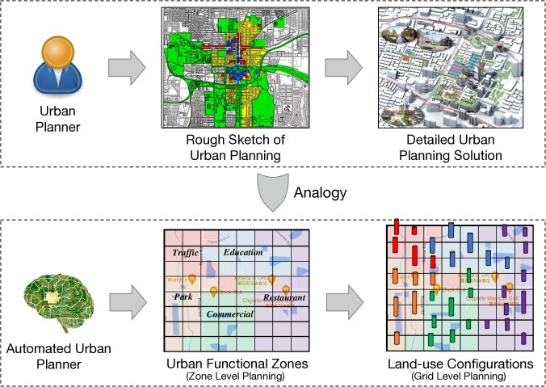
City Planning
https://deepai.org/publication/human-instructed-deep-hierarchical-generative-learning-for-automated-urban-planning

Slide 15
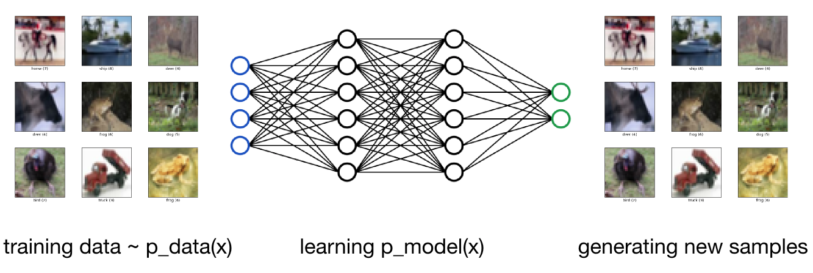
What is generative model?
1. learning p_model(x) that approximate p_data(x)
2. generating new samples x ~ p_model(x)
https://arxiv.org/pdf/1605.07648.pdf

Slide 16
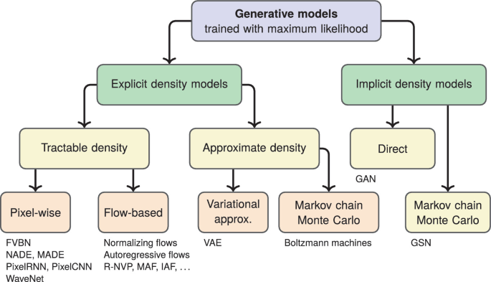
Generative Model Zoo
Nikolenko, S.I. (2021). Generative Models in Deep Learning. In: Synthetic Data for Deep Learning. Springer Optimization and Its Applications, vol 174. Springer, Cham.

Slide 17

Generative Model Zoo
https://lilianweng.github.io/posts/2021-07-11-diffusion-models/

Slide 18
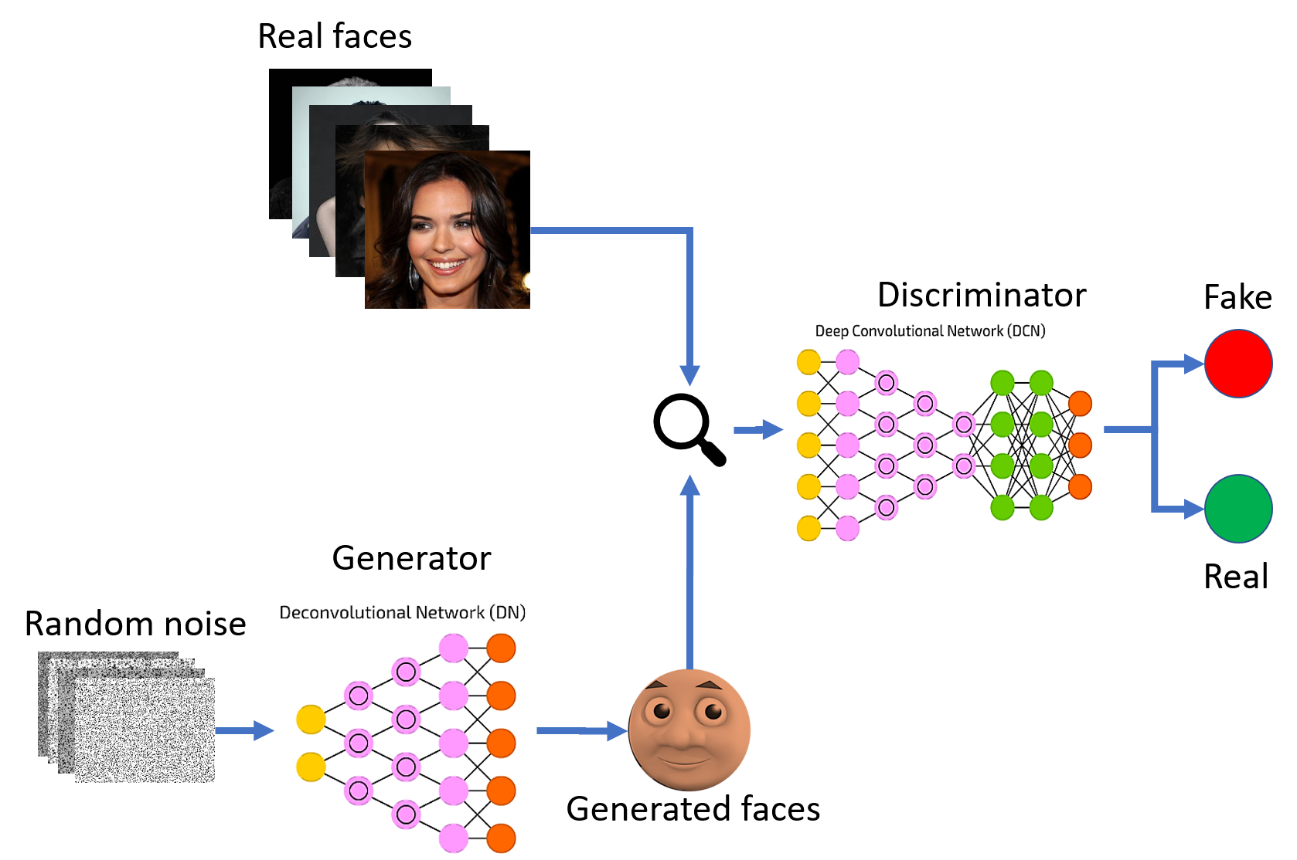
GAN
Latent Space
https://arxiv.org/pdf/1406.2661v1.pdf

Slide 19
GAN
Latent Space
https://arxiv.org/pdf/1406.2661v1.pdf

Slide 20
Deconvolution
更多“人工智能 & 复杂系统”的知识，请关注官网：campus.swarma.org

Slide 21
Review of Convolution Network
卷积层
Convolutional layer(C1)
卷积层(C2)
输出层
卷积层(C3)
卷积层(C4)
池化层(P3)
池化层
Pooling layer(P1)
池化层(P2)
输入层
特征层
更多“人工智能 & 复杂系统”的知识，请关注官网：campus.swarma.org

Slide 22
Review of Convolution
1
1
1
0
1
1
2
3
3
0
1
1
0
0
1
＊
1
0
0
2
3
2
1
0
1
2
2
3
更多“人工智能 & 复杂系统”的知识，请关注官网：campus.swarma.org

Slide 23
Matrix Product & Convolution
卷积运算可以看作矩阵相乘
w_{0,0} | w_{0,1} | w_{0,2}
w_{1,0} | w_{1,1} | w_{1,2}
w_{2,0} | w_{2,1} | w_{2,2}
更多“人工智能 & 复杂系统”的知识，请关注官网：campus.swarma.org

Slide 24
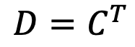
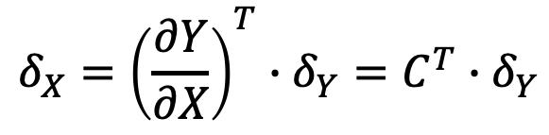
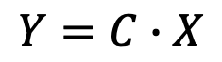
Definition of Deconvolution
卷积运算，C为卷积核对应的矩阵
$$Y=C∙X$$
$$δ_{X}={\left(\frac{∂Y}{∂X}\right)}^{T}∙δ_{Y}=C^{T}∙δ_{Y}$$
误差反传运算，注意是∂Y/ ∂X是Jacobian矩阵
定义D=C^{T}为C对应的反卷积
$$D=C^{T}$$
更多“人工智能 & 复杂系统”的知识，请关注官网：campus.swarma.org

Slide 25
Operation of Deconvolution
将卷积核做两次翻转：上下翻转，左右翻转
更多“人工智能 & 复杂系统”的知识，请关注官网：campus.swarma.org

Slide 26
Operation of Deconvolution
确定特征图padding的大小
将卷积核做两次翻转：上下翻转，左右翻转
用卷积核乘以对应的特征图
更多“人工智能 & 复杂系统”的知识，请关注官网：campus.swarma.org

Slide 27
Antipooling(Upsampling)
更多“人工智能 & 复杂系统”的知识，请关注官网：campus.swarma.org

Slide 28
Upgrading Convolution with Stride
Striding（步伐）为：2
当Striding>1的时候，卷积操作就相当于卷积＋池化了
更多“人工智能 & 复杂系统”的知识，请关注官网：campus.swarma.org

Slide 29
Deconvolution = Convolution with fractional Stride
Stride＝2的卷积的反卷积：
如果要对一个2*2的图像做1/2步伐的卷积操作，那么需要：
1、将任意两个格点之间插入一个空白; 2、在扩充的图上做卷积
更多“人工智能 & 复杂系统”的知识，请关注官网：campus.swarma.org

Slide 30
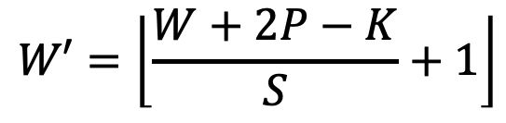
Size Transformation - Convolution
W’：输出图像大小
W：输入图像大小
P：Padding四周加宽的大小
K：卷积窗口大小
S：Striding间隔大小
$$W′=\left\lfloor \frac{W+2P−K}{S}+1\right\rfloor$$
更多“人工智能 & 复杂系统”的知识，请关注官网：campus.swarma.org

Slide 31
Size Transformation - DeConvolution
W’：输出图像大小
W：输入图像大小
P：Padding四周加宽的大小
K：卷积窗口大小
S：Striding间隔大小分之一，即反卷积的1/S间隔
P’: 输出图像的Padding加宽大小
$$W′=\left(W−1\right)S−2P+K+P′$$
更多“人工智能 & 复杂系统”的知识，请关注官网：campus.swarma.org

Slide 32
Deconvolution
更多“人工智能 & 复杂系统”的知识，请关注官网：campus.swarma.org

Slide 33
Deconvolution for MINST
真实图像
生成图像
28
7
100
5
13
5
128
13
28
64
1
更多“人工智能 & 复杂系统”的知识，请关注官网：campus.swarma.org

Slide 34
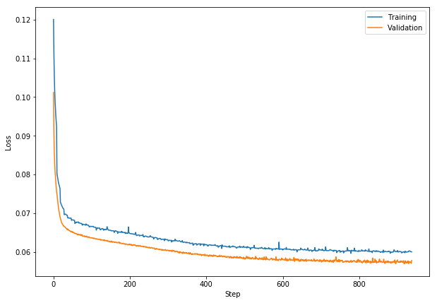
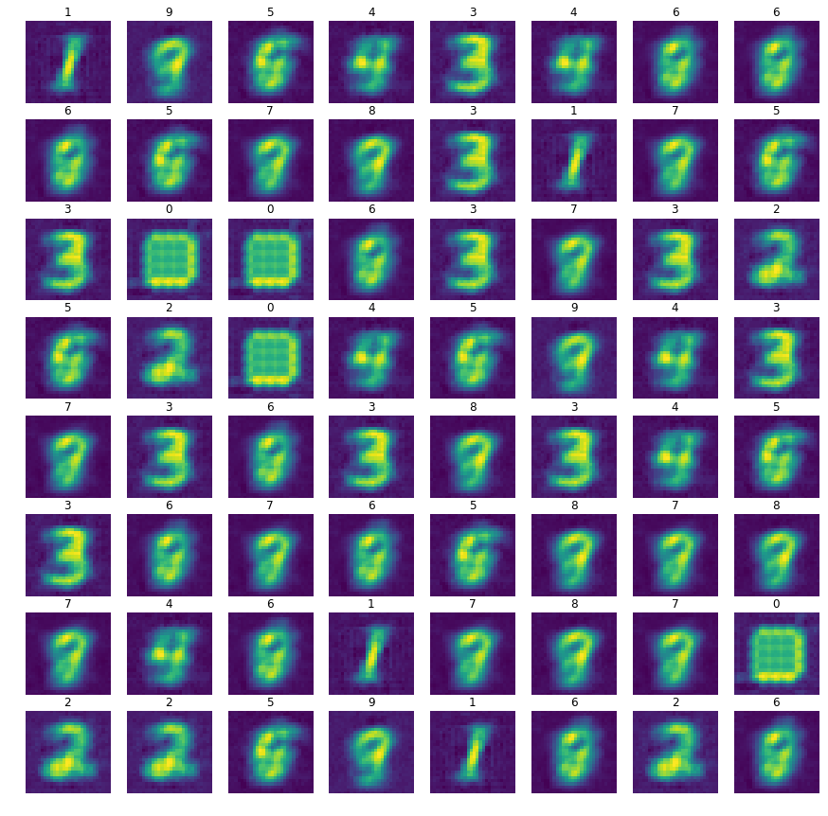
Deconvolution for MINST
真实图像
生成图像
28
7
100
5
13
5
128
13
28
64
1
更多“人工智能 & 复杂系统”的知识，请关注官网：campus.swarma.org

Slide 35
Generator - Recognizer
生成器
识别器
7*7*8
512
10
28
隶属于2的概率
z
28
14
7
7
100
5
13
5
7
7
……
……
128
14
8
13
28
28
4
8
64
4
更多“人工智能 & 复杂系统”的知识，请关注官网：campus.swarma.org

Slide 36
Generator - Recognizer
更多“人工智能 & 复杂系统”的知识，请关注官网：campus.swarma.org

Slide 37
Generator Adversarial Network (GAN)
假的
z
真的
更多“人工智能 & 复杂系统”的知识，请关注官网：campus.swarma.org

Slide 38
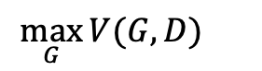
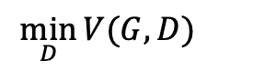
Generator Adversarial Network (GAN)
假的
z
$$\min_{D}{V(G,D)}{}$$
$$\min_{G}{\max_{D}{V(G,D)}=}$$
$$\max_{G}{V(G,D)}{}$$
$$E_{x\sim p_{data}(x)}\log{D(x)}+E_{z\sim p_{z}(z)}\log{(1−D(G(z))}$$
真的
更多“人工智能 & 复杂系统”的知识，请关注官网：campus.swarma.org

Slide 39
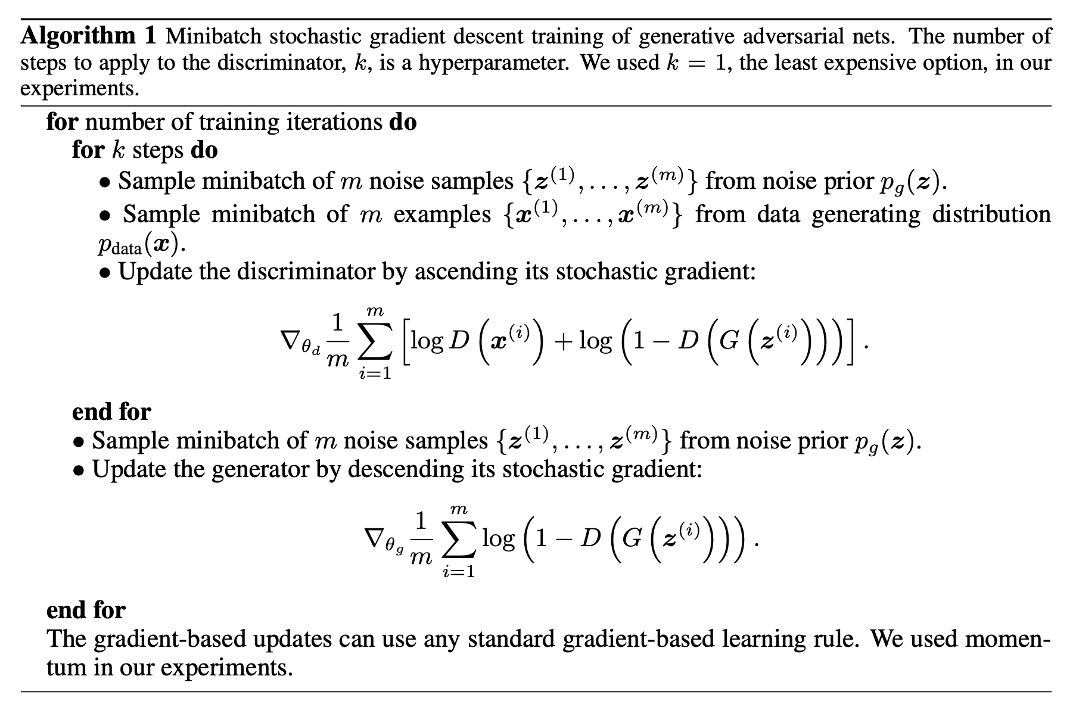
Algorithm
https://arxiv.org/pdf/1406.2661v1.pdf

Slide 40
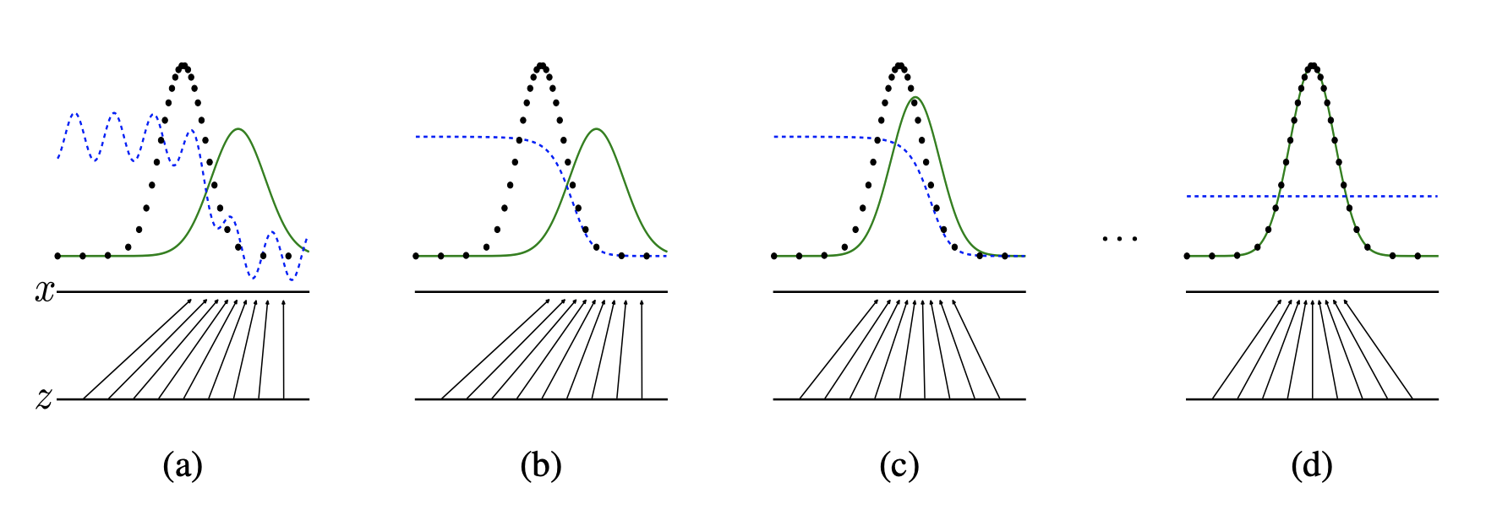
Process of Convergence
数据分布
判别器
生成器生成的分布
https://arxiv.org/pdf/1406.2661v1.pdf

Slide 41
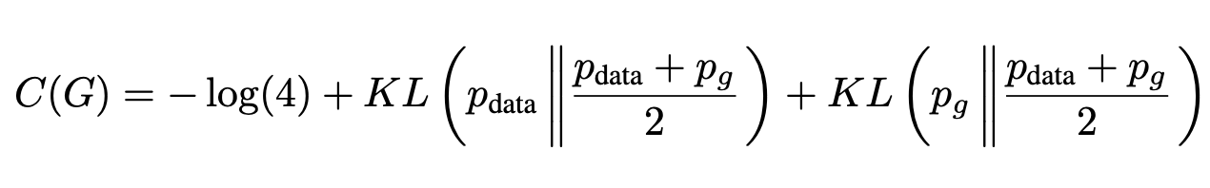
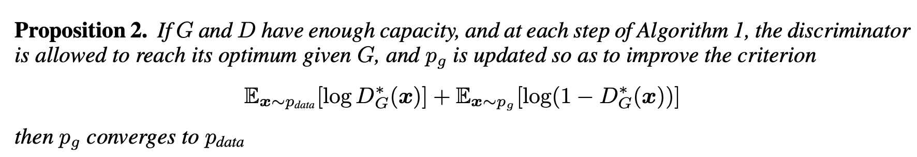
Theoretical Results
https://arxiv.org/pdf/1406.2661v1.pdf

Slide 42
Generator
class ModelG(nn.Module):
def __init__(self):
super(ModelG,self).__init__()
self.model=nn.Sequential()
self.model.add_module('deconv1',nn.ConvTranspose2d(input_dim, num_features*2, 5, 2, 0, bias=False))
self.model.add_module('bnorm1',nn.BatchNorm2d(num_features*2))
self.model.add_module('relu1',nn.ReLU(True))
self.model.add_module('deconv2',nn.ConvTranspose2d(num_features*2, num_features, 5, 2, 0, bias=False))
self.model.add_module('bnorm2',nn.BatchNorm2d(num_features))
self.model.add_module('relu2',nn.ReLU(True))
self.model.add_module('deconv3',nn.ConvTranspose2d(num_features, num_channels, 4, 2, 0,bias=False))
self.model.add_module('tanh',nn.Tanh())
def forward(self,input):
output = input
for name, module in self.model.named_children():
output = module(output)
return(output)

Slide 43
Discriminator
class ModelD(nn.Module):
def __init__(self):
super(ModelD,self).__init__()
self.model=nn.Sequential()
self.model.add_module('conv1',nn.Conv2d(num_channels, num_features, 5, 2, 0, bias=False))
self.model.add_module('relu1',nn.LeakyReLU(0.2, inplace = True))
self.model.add_module('conv2',nn.Conv2d(num_features, num_features * 2, 5, 2, 0, bias=False))
self.model.add_module('bnorm2',nn.BatchNorm2d(num_features * 2))
self.model.add_module('linear1', nn.Linear(num_features * 2 * 4 * 4, num_features))
self.model.add_module('linear2', nn.Linear(num_features, 1))
self.model.add_module('sigmoid',nn.Sigmoid())
def forward(self,input):
output = input
for name, module in self.model.named_children():
if name == 'linear1’:
output = output.view(-1, num_features * 2 * 4 * 4)
output = module(output)
return(output)

Slide 44
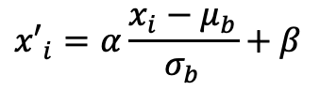
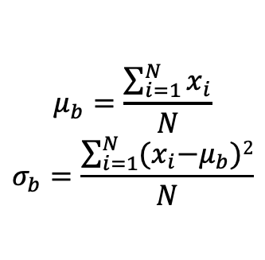
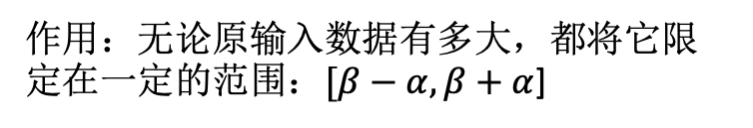
Practical Tricks – Batch Normalization
BN
作用：无论原输入数据有多大，都将它限定在一定的范围：$[β−α, β+α$]
BN
$${x′}_{i}=α\frac{x_{i}−μ_{b}}{σ_{b}}+β$$
BN
$$μ_{b}=\frac{\sum_{i=1}^{N}{x_{i}}}{N}$$
$$σ_{b}=\frac{\sum_{i=1}^{N}{{(x}_{i}−μ_{b})2}}{N}$$
http://jiangqh.info/Batch-Normalization%E8%AF%A6%E8%A7%A3/

Slide 45
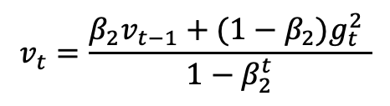
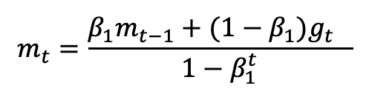
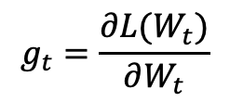
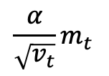
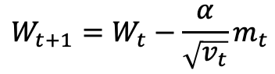
Practical Tricks – Adam Optimizer
w₂
$$W_{t+1}=W_{t}−\frac{α}{\sqrt{v_{t}}}m_{t}$$
学习率可以调节
学习率越来越小
学习率有惯性
利用历史梯度信息
越老的梯度信息影响越小
梯度调整值有惯性
$$\frac{α}{\sqrt{v_{t}}}m_{t}$$
$$v_{t}=\frac{β_{2}v_{t−1}+(1−β_{2})g_{t}^{2} }{1−β_{2}^{t}}$$
$$m_{t}=\frac{β_{1}m_{t−1}+(1−β_{1})g_{t}^{} }{1−β_{1}^{t}}$$
$$g_{t}=\frac{∂L(W_{t})}{∂W_{t}}$$
w₁
https://arxiv.org/pdf/1609.04747.pdf

Slide 46
Practical Tricks – Leaky ReLU
ReLU(x)=max(0,x)
ReLU的问题：神经元坏死（dead ReLU problem）
LeakyReLU(x)=max(ax,x)

Slide 47
Practical Tricks – Weights Initialization
初始化权重的困境：
如果太大，则很容易被深度放大
如果太小，则很容易被深度消失
常用方案：
0权重
小方差权重：W=0.01 * np.random.randn(D,H)
Xavier初始化（为了保持输入与输出的方差一致）：
W= np.random.randn(D,H)/sqrt(N_{i})
Weight_init
卷积核：W= 0.02 * np.random.randn(D,H)
BatchNorm: W=1 + 0.02* np.random.randn(D,H)

Slide 48
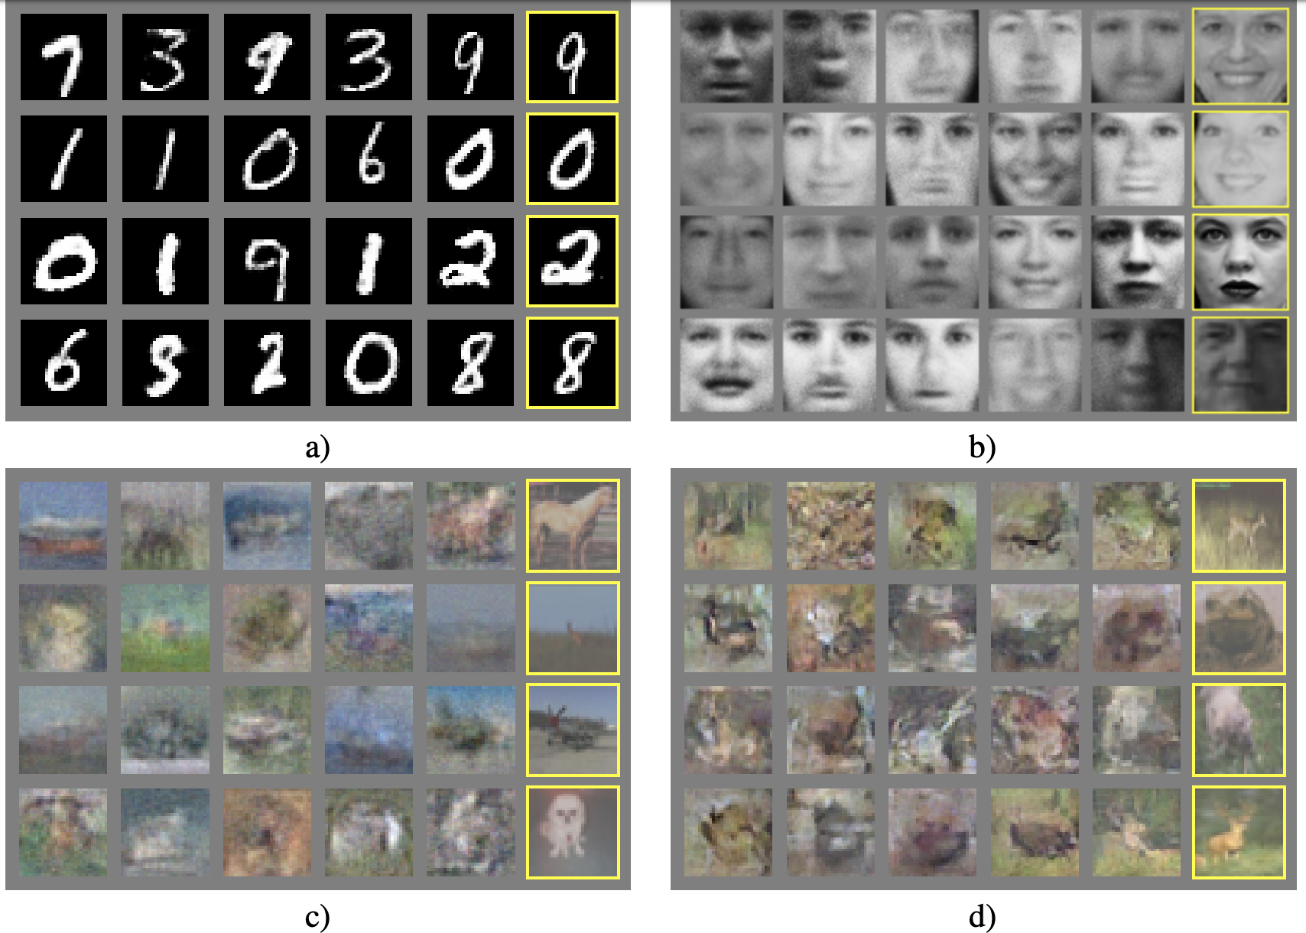
Experimental Results
https://arxiv.org/pdf/1406.2661v1.pdf

Slide 49
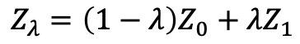
Noise Vector
Z(1)
Z(5)
$$Z_{λ}=\left(1−λ\right)Z_{0}+λZ_{1}$$
Z(7)
Z(1)
https://arxiv.org/pdf/1406.2661v1.pdf

Slide 50
Vector Algebra
https://arxiv.org/pdf/1406.2661v1.pdf

Slide 51
More GANs – Conditional GAN
Jon Gauthier: Conditional generative adversarial nets for convolutional face generation, CoRR, abs/1411.1784, 2014.

Slide 52
More GANs – Conditional GAN
random
+age
+mouth open
Jon Gauthier: Conditional generative adversarial nets for convolutional face generation, CoRR, abs/1411.1784, 2014.

Slide 53
More GANs – Conditional GAN
Scott Reed et al., Generative Adversarial Text to Image Synthesis, arXiv:1605.05396v2

Slide 54
More GANs – Conditional GAN
Scott Reed et al., Generative Adversarial Text to Image Synthesis, arXiv:1605.05396v2

Slide 55
Translation between Images
Phillip Isola et al., Image-to-Image Translation with Conditional Adversarial Networks, arXiv:1611.07004v1, 2016

Slide 56
Translation between Images
Phillip Isola et al., Image-to-Image Translation with Conditional Adversarial Networks, arXiv:1611.07004v1, 2016

Slide 57
Translation between Images
生成器
辨别器
Phillip Isola et al., Image-to-Image Translation with Conditional Adversarial Networks, arXiv:1611.07004v1, 2016

Slide 58
Translation between Images
Phillip Isola et al., Image-to-Image Translation with Conditional Adversarial Networks, arXiv:1611.07004v1, 2016

Slide 59
Dual Learning

Slide 60
Cycle GAN
Jun-Yan Zhu et al.:Unpaired Image-to-Image Translation using Cycle-Consistent Adversarial Networks, arXiv:1703.10593v1, 2017

Slide 61
Cycle GAN
Jun-Yan Zhu et al.:Unpaired Image-to-Image Translation using Cycle-Consistent Adversarial Networks, arXiv:1703.10593v1, 2017

Slide 62
Cycle GAN
Jun-Yan Zhu et al.:Unpaired Image-to-Image Translation using Cycle-Consistent Adversarial Networks, arXiv:1703.10593v1, 2017

Slide 63
Summary for GAN
Advantages
High-quality data generation
Unsupervised learning
Flexibility: GANs can work with a variety of data types
Disadvantages
Instability: mode collapse, oscillation
Evaluation: no definitive method for evaluating
Sensitivity to hyperparameters: learning rate, batch size
ChatGPT provides

